Slide 1


Music genre perception of non-musicians and musicians

Slide 2
Theory & Hypothesis
Theory
Musicians have a deeper knowledge of music genres
when they play a genre they think more about this genre and how it is different from other ones
spend more time in analyzing the way a piece of music is played/ structure of a piece of music (timing, sequencing, spatial organization of movement)
invent own music: think of possibilities in music
Hypothesis
Musicians will have different patterns in their RDMs than non-musicians
greater distances between different genres in musicians
greater distances between different subgenres in musicians

Slide 3
Definition of Musician
Minimum of 10 years of musical training
Currently practicing more than 1 hour/ week
Musical training = playing an instrument or singing in a choir

Slide 4
Definition of Non-Musician
Less than 2 years of musical training
Currently not practicing at all
Only listening to music

Slide 5
Music genre perception
music genre is a conventional category that identifies some pieces of music as belonging to a shared tradition or set of convention
automatic music genre classification
based on music features
objective?
no: algorithm needs assumptions and those are chosen by human theories
music genre classification by theories
subjective
there will always be a discussion about the different music genres and how they should be defined and which pieces of music belong to them

Slide 6
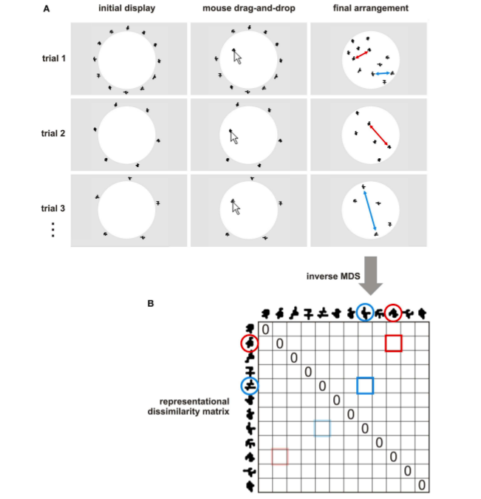
Design
Notes:
Independent variable
Musical training which is assessed in 2 categories
Musician
Non-Musician
Dependent variable
Similarity perception of different music genres

Slide 7
Material
in sum 20 music stimuli
validated by other people
4 main categories and 5 subcategories
Rock: Alternative, rock‘n‘roll, heavy metal, psychedelic, punk
Classic: Baroque, classic, modern classic, rennaissance, romantic
African-American: funk, hip hop, reggae, r‘n‘b, soul
Electro: Techno, deephouse, drum‘n‘bass, dubstep, trance

Slide 8
Our description of the music genres

Slide 9
Procedure
person is sitting in a calm room in front of a pc with headphones
behavioral experiment
2 questionnaires asking for music preferences
,,Music Preference Questionnaire” (MPQ-R; Nater et al. 2005)
,,Short Test of Music Preferences” (STOMP; Rentfrow & Gosling 2003)
2 auditory tests to test understanding of music/ musical competence
Montreal Battery of Evaluation of Amusia (MBEA; Peretz et al. 2003)
Musical Ear Test (MET; Wallentin et al. 2010)

Slide 10
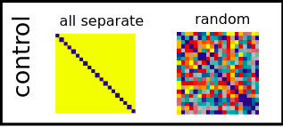
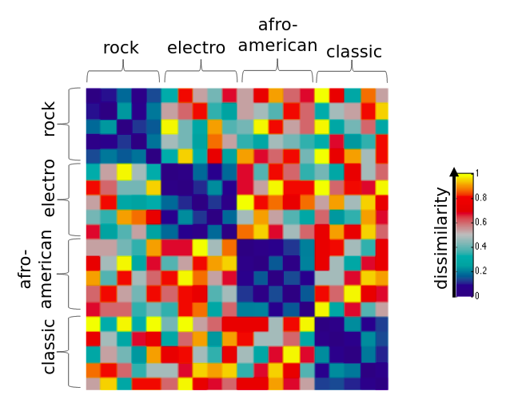
Optimal result models
control models:
to make a differentiation between systematic arrangement, random arrangement or all seperate arrangement
this pattern should be different between musicians and non-musicians
musicians: more dissimilarities in the main genres and more dissimilarities between the subgenres
non-musicians: less dissimilarities in the main genres and less dissimilarities between the subgenres
threshold is not defined yet

Slide 11
What will be tested against each other?
random model vs. assessed model
all seperate model vs. assessed model
musicians model vs. assessed model
non-musicians model vs. assessed model

Slide 12
Expectancies of results
people defined as musicians should be the most equal to musician-model
people defined as non-musicians should be the most equal to non-musician-model
assessed models of musicians shouldn’t be equal to assessed models of non-musicians
all assessed models shouldn’t be equal to control models
random
all seperate

